Slide 1
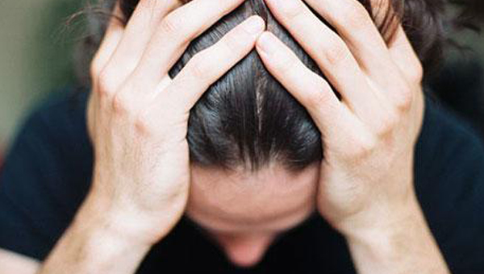
Trust or Worry
Matthew 6:25-34
Dr. Rick Griffith, Crossroads International Church Singapore
www.BibleStudyDownloads.org

Slide 2
Black

Slide 3
The glass
Notes:
What do you see? Tell your neighbor.
Did you see a glass half empty or half full?

Slide 4
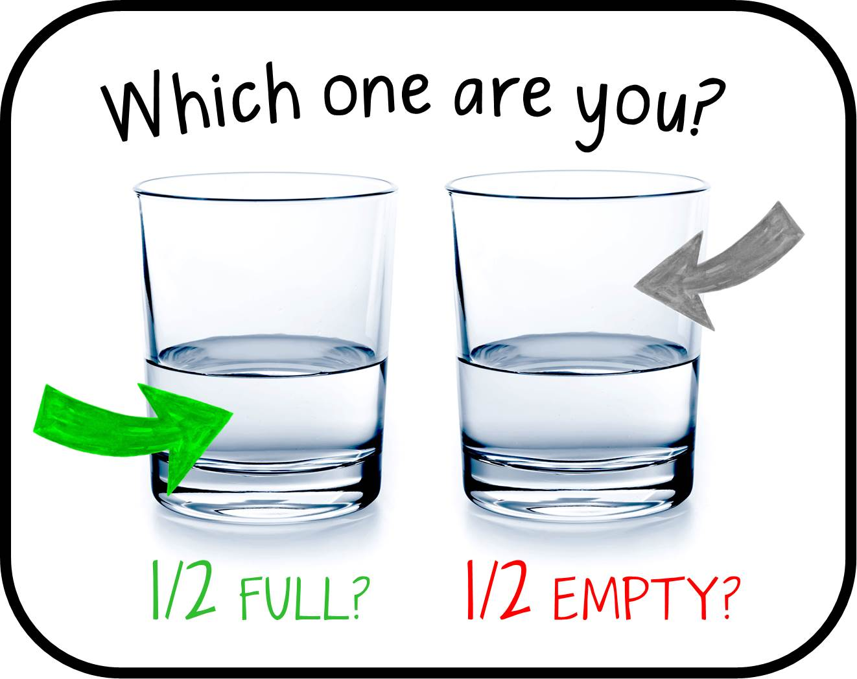
Which one are you?
1/2 FULL?
1/2 EMPTY?
Notes:
If the glass is half full, you are focusing on the water still there. You see a nice glass with clean, pure water to drink.
If the glass is half empty to you, maybe you wonder why.

Slide 5
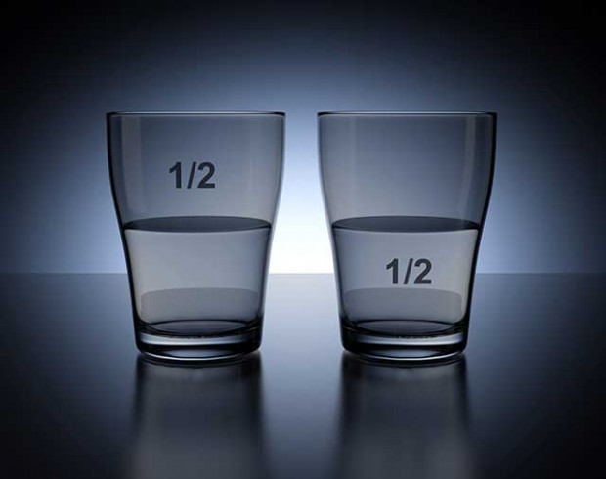
The glass
Notes:
What happened to the water that used to be up to the top? Even worse, maybe there was never that much water in the first place.

Slide 6
Worry.
Notes:
Are you a worrier? Do you worry?

Slide 7
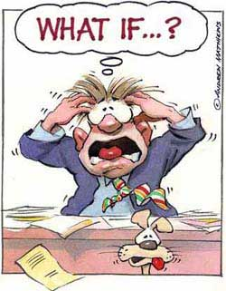
What if…?
Notes:
Do you find your mind wandering about the "what ifs…" in your life?

Slide 8
Worry.
Notes:
Are you concerned that you just don't fit in at work?

Slide 9
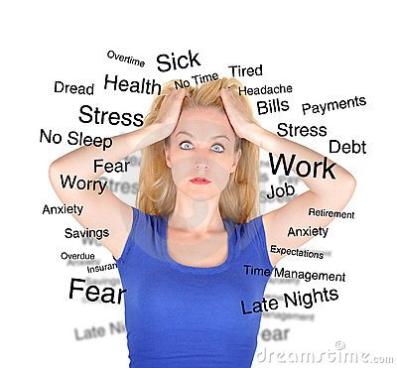
Worry.
Notes:
Do you stock up stuff "just in case"?
Are you at peace in life?
Do you carry baggage from the past?
Are you at rest about the future—or anxious about it?

Slide 10
How can you be free from worry?
Notes:
How can you be free from worry? What's God's prescription for anxiety?

Slide 11
Worries, then and now.
Notes:
In Jesus' time, both the Pharisees and the common people worried.
Pharisees sought wealth to relieve worries about the future—just like us today.

Slide 12
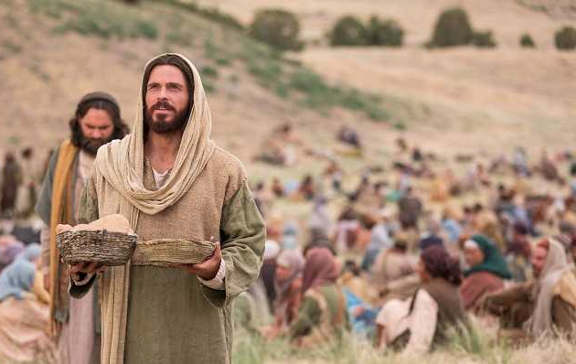
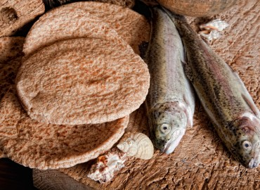
Worries, then and now.
Notes:
The common people worried about food and clothes.
• That's one reason so many came to hear Jesus teach, as it sometimes included a free lunch!

Slide 13
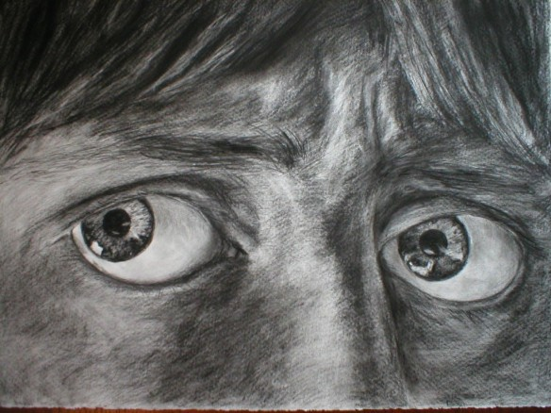
Today we'll see three ways not to worry.
Matthew 6:25-34
Notes:
Today we'll see three ways not to worry.
• Matthew 6:25-34 is the Bible's best text to defeat worry.
The first way to free you from worry is to…

Slide 14
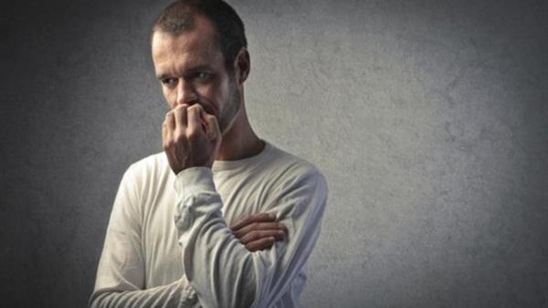
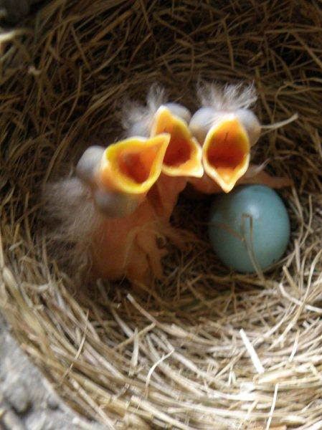
I. Realize that God feeds you while worry eats you up (6:25-27).
Notes:
Know the Lord gives you food—but anxiety doesn't let you enjoy that food.

Slide 15
Don't worry about food, drink, or clothes (6:25).
"Therefore I tell you, do not worry about your life, what you will eat or drink; or about your body, what you will wear. Is not life more important than food, and the body more important than clothes?" (NIV).
Notes:
What is the "therefore" there for (6:25)?

Slide 16
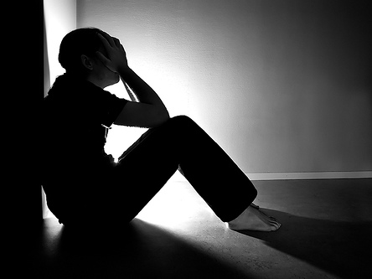
An Objection: "But if I lay up treasures in heaven, how will I have enough here on earth?"
Notes:
Well, Jesus just finished telling us to save for heaven rather than for earth.
Now Jesus anticipates a natural objection of his listeners: "If a person is occupied with the things of God, the true Master, how will he care for his ordinary needs in life, such as food, clothing, and shelter?" (Barbieri, "Matthew," BKC, 2:33).

Slide 17
"The person who pursues money thinks that riches will solve his problems, when in reality, riches will create more problems! Material wealth gives a dangerous, false sense of security, and that feeling ends in tragedy" (Warren Wiersbe, BE Series, 62).
Notes:
Wiersbe says it well…

Slide 18
WHAT WE WORRY ABOUT…
FOOD
DRINK
CLOTHES
FUTURE
Notes:
What things does Jesus say not to worry about (6:25-34)?

Slide 19
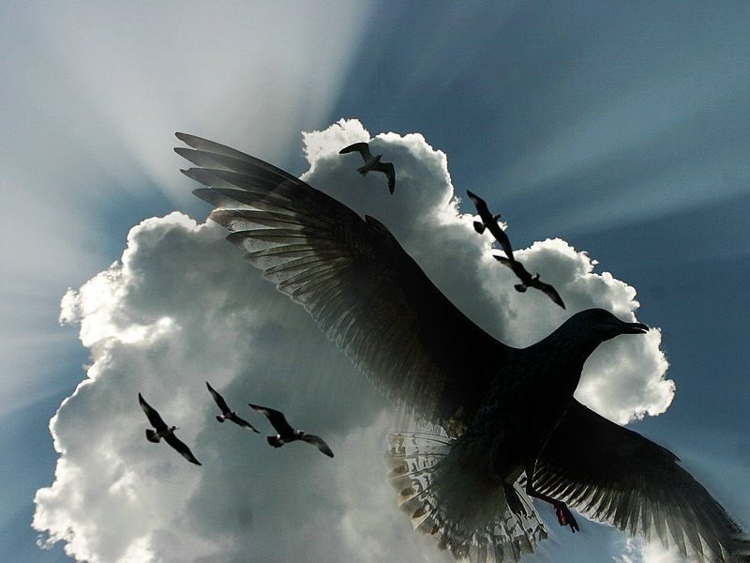
God will feed you more than diligent birds as He values you more (6:26).
"Look at the birds of the air; they do not sow or reap or store away in barns, and yet your heavenly Father feeds them. Are you not much more valuable than they?" (NIV).
Notes:
We might think that Christ would address the need for shelter, but he actually doesn't even mention it. He tells us that since God cares for plants and animals that are less valuable than us, we have reason to trust in God to care for us who are made in his image!

Slide 20
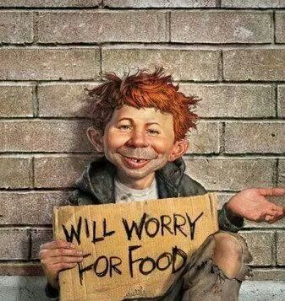
Will worry for food
Notes:
Do we really worry about food (6:25)?
Yes, definitely! Singaporeans typically ask, "Have you eaten?" I wonder if anyone is going hungry here in this prosperous nation!
Some friends have passed by hundreds of restaurants to get to the stall they love most—or one on the other side of the country that sells the same food for a dollar less!
We worry about where we going to eat after church! For some of us, this is really a big deal.

Slide 21
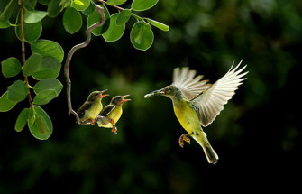
God will feed you more than diligent birds as He values you more (6:26 NIV):
"Look at the birds of the air; they do not sow or reap or store away in barns, and yet your heavenly Father feeds them. Are you not much more valuable than they?”

Slide 22
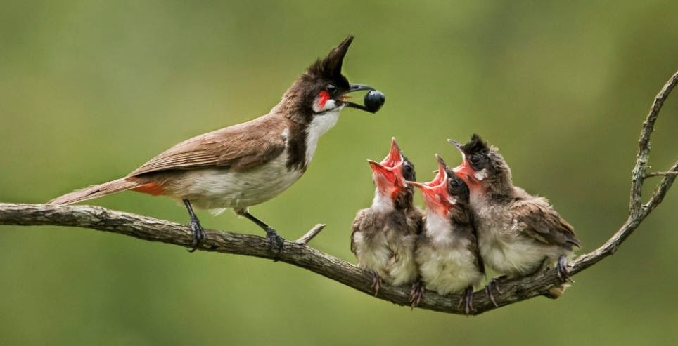
God will feed you more than diligent birds as He values you more (6:26).
"Look at the birds of the air; they do not sow or reap or store away in barns, and yet your heavenly Father feeds them. Are you not much more valuable than they?" (NIV).
Notes:
Birds need an enormous amount of food daily—often twice their body weight! Yet God provides enough seed for them.
You are worth far more than a bird to God!

Slide 23
Worry doesn't help us live even one hour longer (6:27).
"Who of you by worrying can add a single hour to his life?" (NIV).

Slide 24
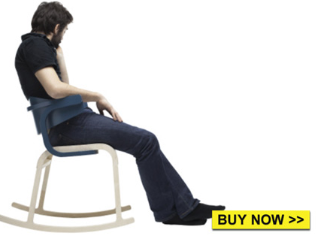
Don't Worry.
WORRYING IS LIKE A ROCKING CHAIR. IT GIVES YOU SOMETHING TO DO, BUT DOESN'T GET YOU ANYWHERE.

Slide 25
"Worry never robs tomorrow of its sorrow. It only saps today of its joy." —Leo Buscaglia

Slide 26
Do people think that worry will give them a longer life (6:27)?
Notes:
Well, I think we do this all the time.
We spend a great deal of our time planning for our retirement and saving for this time—all accompanied not by wise planning but by worry.
We worry if we will be healthy today and tomorrow. Worry causes many physical problems that ruin our health.
"Jesus said that worry is sinful. We may dignify worry by calling it by some other name—concern, burden, a cross to bear—but the results are still the same. Instead of helping us live longer, anxiety only makes life shorter (Matt. 6:27)" (Wiersbe, BE Series, 62).
Worry won't lengthen your life, but it likely will shorten it.

Slide 27
How can you be free from worry?

Slide 28
I. Realize that God feeds you while worry eats you up (6:25-27).
Notes:
Know the Lord gives you food—but anxiety doesn't let you enjoy that food.
The second way to free you from worry is to…

Slide 29
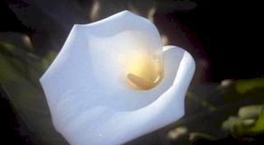
II. Realize that God clothes nature without nature worrying (6:28-30).
Notes:
Know that God provides your garments whether you fret about them or not.

Slide 30
Don't worry about clothes (6:28a).
"And why do you worry about clothes?" (NIV).
Notes:
Do we really worry about clothing (6:26)?

Slide 31
Madison Avenue Clothes
Notes:
Unfortunately, Madison Avenue tells us to worry about clothing to pad their pocketbooks.

Slide 32
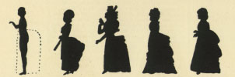
Our Worry About Clothes
1780
1790
1875
1890
Notes:
Are our clothes really too old or out of style—every year? Must styles change so fast?

Slide 33
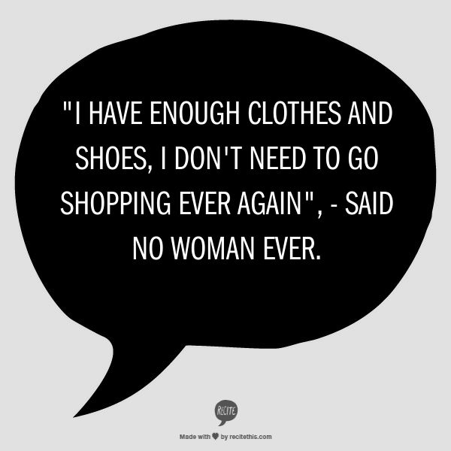
Worry.
"I have enough clothes and shoes. I don't need to go shopping ever again," said no woman ever.

Slide 34
Worry.
Notes:
Don't we all have enough pants, shirts, blouses, and dresses? Why must we worry about such things?

Slide 35
Wealth insulates us.
Notes:
Wealth insulates us from the life of faith. That's why one of my Singapore friends decided that his $40,000 a month job would be a hindrance to him. He even made as much as $80,000 monthly 20 years ago! He went away as a missionary and now he makes less than $40,000 a year, but God has taken care of him and his wife. He's also full of joy!

Slide 36
God clothes lilies even better than he clothed Solomon (6:28b-29).
"See how the lilies of the field grow. They do not labor or spin. ²⁹Yet I tell you that not even Solomon in all his splendor was dressed like one of these" (NIV).

Slide 37
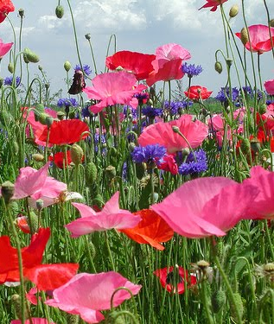
God cares for passing grass, so he'll care for precious people like us (6:30).
"If that is how God clothes the grass of the field, which is here today and tomorrow is thrown into the fire, will he not much more clothe you, O you of little faith?" (NIV).

Slide 38
How can you be free from worry?

Slide 39
I. Realize that God feeds you while worry eats you up (6:25-27).
Notes:
Know the Lord gives you food—but anxiety doesn't let you enjoy that food.

Slide 40
II. Realize that God clothes nature without nature worrying (6:28-30).
Notes:
Know that God provides your garments whether you fret about them or not.

Slide 41
III. Trust God that you'll rule with Jesus (6:31-34).
Notes:
Believe that God's coming kingdom includes you if you don't worry.

Slide 42
Therefore, replace worry with seeking Christ's rule on earth (6:31-33).
"So do not worry, saying, 'What shall we eat?' or 'What shall we drink?' or 'What shall we wear?' ³²For the pagans run after all these things, and your heavenly Father knows that you need them. ³³But seek first his kingdom and his righteousness, and all these things will be given to you as well" (NIV).

Slide 43
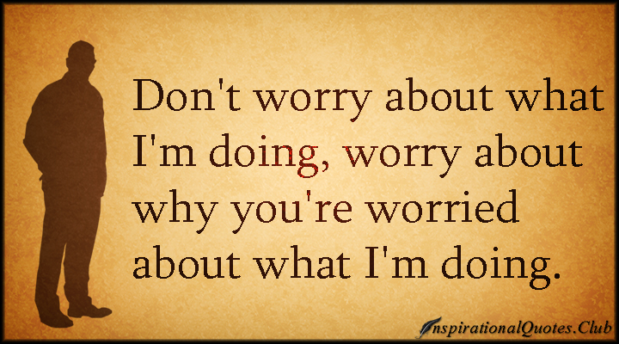
"Don't worry about what I'm doing. Worry about why you're worried about what I'm doing."
Notes:
To worry about material things is to live like pagans (6:31-32).

Slide 44
HIS KINGDOM & HIS RIGHTEOUSNESS
Notes:
What does it mean to seek God's kingdom (6:33)?
We ask kids, "What do you want to be when you grow up?" Instead, we should ask them, "What do you believe God wants you to be when you grow up?"
Linked-In tells me to position myself and make all the right connections for my next job, assuming that I am dissatisfied right now.

Slide 45
The Kingdom of God
34
The Eternal Kingdom
False Kingdom of Satan
Soteriological Line
Theocratic Kingdom on Earth
Eden | Conscience
Human Government
Patriarchs | Judges | Kings | Prophets | Christ | Grace
Millennium
Israel | Times of Gentiles
Covenants
Abrahamic Covenant
Land Covenant
Davidic Covenant
New Covenant
Dispensations (Tests of Obedience)
Inno-cence | Conscience
Human Government
Promise | Law (Gal. 3:19) | Grace
Millennium
J. Dwight Pentecost, Thy Kingdom Come, 323
Notes:
God, instead, tells us to plan for the time when Jesus will rule on this earth!

Slide 46
Therefore, replace cares for tomorrow with trust in God today (6:34).
"Therefore do not worry about tomorrow, for tomorrow will worry about itself. Each day has enough trouble of its own" (NIV).
Notes:
How will tomorrow worry about itself (6:34a)?
Time does not worry, of course.

Slide 47
Don't worry about
tomorrow
God is already there!
Notes:
Don't worry about tomorrow—God is already there! As Wiersbe notes, "Worrying about tomorrow does not help either tomorrow or today. If anything, it robs us of our effectiveness today—which means we will be even less effective tomorrow. Someone has said that the average person is crucifying himself between two thieves: the regrets of yesterday and the worries about tomorrow. It is right to plan for the future and even to save for the future (2 Cor. 12:14; 1 Tim. 5:8). But it is a sin to worry about the future and permit tomorrow to rob today of its blessings" (Wiersbe, BE Series, 62).

Slide 48
—Corrie ten Boom—
WORRYING DOES NOT EMPTY TOMORROW OF ITS TROUBLES • • • • • • • • • IT EMPTIES TODAY OF ITS STRENGTH
Notes:
Is that negative to say that each day has enough trouble of its own (6:34b)?
Not really. Jesus is saying that we can only handle so much.
Jesus is actually saying that each day has enough challenges.
God has not given us grace for tomorrow just yet. But that grace will come tomorrow in full supply.

Slide 49
How can you be free from worry?

Slide 50
The Main Idea
Replace worry with trust.
Notes:
Believe God instead of being anxious (MI restated).
DON'T WORRY—TRUST INSTEAD!

Slide 51
I. Realize that God feeds you while worry eats you up (6:25-27).
Notes:
Know the Lord gives you food—but anxiety doesn't let you enjoy that food.

Slide 52
II. Realize that God clothes nature without nature worrying (6:28-30).
Notes:
Know that God provides your garments whether you fret about them or not.

Slide 53
III. Trust God that you'll rule with Jesus (6:31-34).
Notes:
Believe that God's coming kingdom includes you if you don't worry.

Slide 54
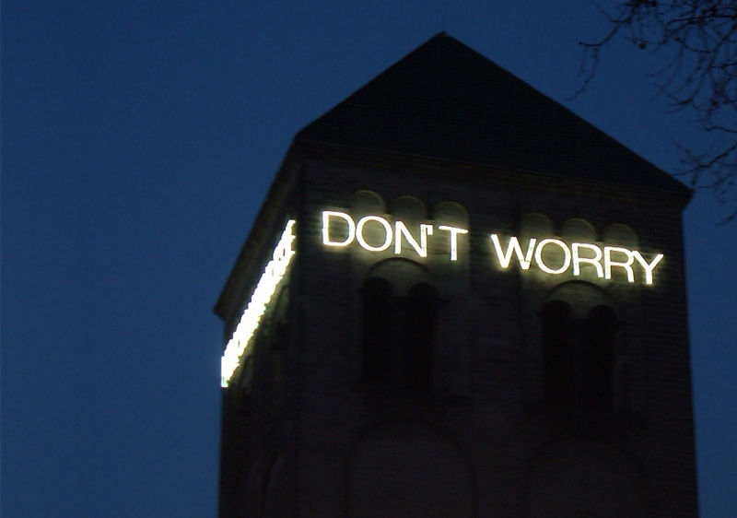
"Don't worry."
Verses 25, 31, 34
Notes:
Jesus told us three times in this text, "Don't worry."

Slide 55
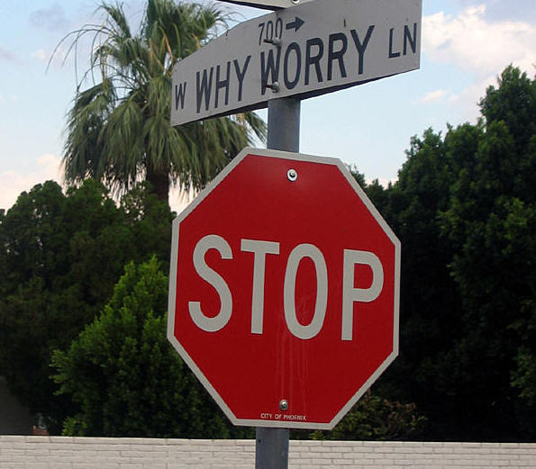
Worry.
Notes:
Basically, stop when you're at Why Worry Lane!

Slide 56
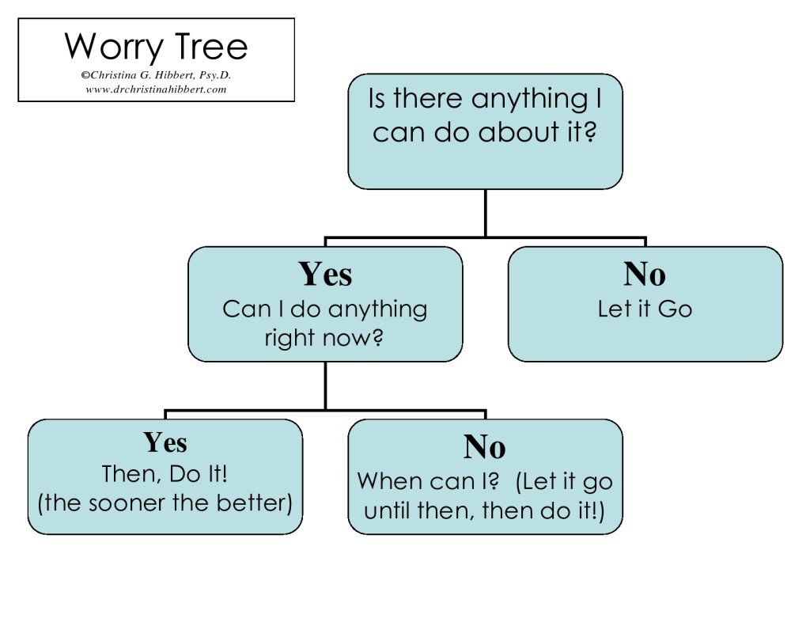
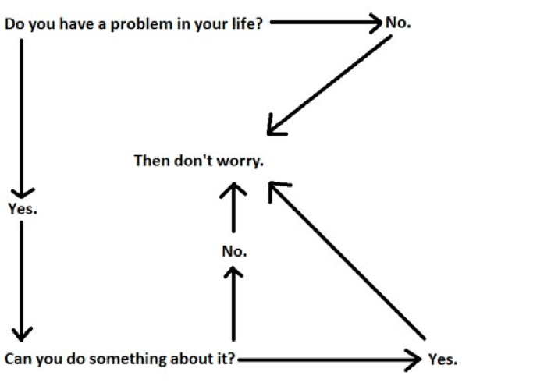
Worry Flow Chart
Is there anything I can do about it?
YES Can I do anything right now?
NO Let it go.
YES Then, Do It! (the sooner, the better)
NO When can I? (Let it go until then, then do it!)
Notes:
The Key to Worry-Free: The Worry Tree
May 3, 2012 by Dr. Christina Hibbert
http://www.drchristinahibbert.com/the-key-to-worry-free-the-worry-tree/
Accessed 1 May 2016
What's the Key to Worry-Free?:
The Worry Tree
I got up at 5 on Monday morning to work on my book before the kids woke up. 30 minutes in I was feeling terrific about my writing "flow" when my computer suddenly went blank and a warning came up: "Critical Error!" I tried not to panic as I called tech support, reminding myself that I at least had a backup drive with most of my work from the past 5 years saved on it. The tech guy told me I'd contracted a mega virus; "one of the very worst," he said. I handled it pretty well until I realized seven hours later that our attempt to save my computer files had failed and that my backup drive had somehow been deleted!
Why Worry?
We've all experienced times like this or worse when we feel the panic of a "critical error!" and find it near impossible to stop the endless stream of worries, fears, and anxieties. But at some point we must learn to accept the truth about worry: Worry is not only pointless, it can actually be harmful! I always say, "Worry is good for nothing," and I believe it. Worrying is a form of avoiding making a decision or taking action. Instead of acting, we en-act the scene over and over in our minds, thus increasing our discomfort and wasting our time. Worrying can also lead to unnecessary harmful behaviors like eating or drinking too much or falling into despair or depression–behaviors that could have been avoided if the worry could have been stopped. In fact, does it ever really help to worry? No. Isn't it better to either do something about it or let it go? The answer is yes. But the question, then, is how?
The Worry Tree
I've created a simple method I call the "Worry Tree." Remember, worry is simply a feeling, albeit a powerful feeling, and the only good thing we can take from feeling worried is the signal that something needs our attention. The Worry Tree helps us put our attention where it is most productive, alleviating the extra stress and wasted time of prolonged worry.
I'll give you an example: "My son is not home yet and it's 15 minutes past curfew! He never does this!" The feeling of worry comes on in full force. The good news is that the worry is putting my attention where it needs to be—on the safety of my child. But there is an underlying assumption feeding this worry too: "Something must be terribly wrong!" Notice how quickly worry jumps to conclusions? And jumping to conclusions can cause all kinds of trouble.
Instead, I'll use the Worry Tree.
First I ask myself, "Is there anything I can do about this?" If the answer is "No," if, in our example, my son doesn't have a cell phone and there is no other way to get in touch with him—then the action I must take is let go of the worry for now and hope for the best. Now, we all know it can be hard to let go of worry, so distracting yourself is a great option. In our example I might remind myself that "it's only been 15 minutes after all and chances are he's fine," then go read a book or finish a project. Then, when he shows up ten minutes later, I'm calm, I've alleviated the extra stress of worry, and though there will likely be a consequence for his behavior, he is less likely to get completely reamed.
If, however, I answered "Yes, there is something I can do about this,"–for instance, if my son has a cell phone that I can call—then I ask a second question, "Can I do anything right now?" If the answer is again "Yes," then we take immediate action; in this case I call my son and learn he will be home soon. Taking action is the best way to alleviate worry, and the sooner we take action, the better.
Many times there is something I can do, but I need to wait to do it (perhaps I need to resolve a situation with a co-worker or friend but they're not available until next week). When we answer, "No, I cannot do anything right now," and have to wait to take action, then we must let the worry go until the time when the action can be taken. Again, by pushing worry away until we can do something about our "critical" situation we find that we usually didn't need the worrisome feelings at all, and we're much happier in the meantime!
So, Remember…
Worry is simply a way for us to avoid making decisions or taking action. Thus, by taking action and making those decisions worry loses its power. We then begin to see that worry never had any real power anyway—only the borrowed power that we decided to give it. Four days later I'm still waiting for the outcome of my "critical" computer crash, but I've kept most of my power by distracting myself away from the worry for the most part (and I have a cleaner house as a result)! So the next time you find yourself worrying, pull out the worry tree and get to work. You will quickly see that the worry tree is the key to being worry-free!

Slide 57
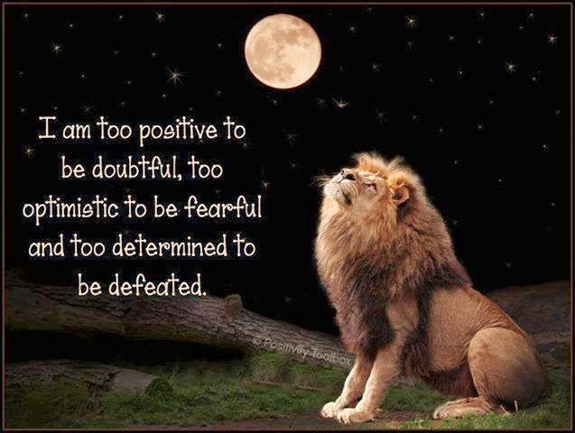
I am too positive to be doubtful, too optimistic to be fearful and too determined to be defeated.

Slide 58
Black

Slide 59
NT Sermons link at BibleStudyDownloads.org
Get this presentation and script for free!
Listen to this message at cicfamily.com

